Slide 1
Stock Market Management System
INFO 5100 Final Project

Slide 2
Our team
Shaiz Mohammad
Christina Raymond
Maseerah Khatoon
Habeebuddin Mir
002796856
002746856
002778147
002713929

Slide 3
Table of contents
Problem
Solution
01
02
Model Representation
Output
03
04
Problem statement of the application
Objective of the application that is built
Class, sequence and use case diagrams
Application results

Slide 4
Introduction
The stock market is made up of exchanges such as the New York Stock Exchange and the Bombay Stock Exchange. A particular exchange serves as a market for the shares of the stocks that are listed there by bringing buyers and sellers together. The exchange keeps track of each stock's supply, demand, and price in direct relation to each.

Slide 5
Problem Statement
To build an application for Stock exchange on the digital platform that serves as a system for specialists to buy, sell or view stocks or commodities. It also includes administrative personnel that may add or modify business stocks.

Slide 6
Solution
Allows users to trade both commodities and stocks.
A business founder has the ability to establish a new company, obtain a business licence, and list their firm on the stock market.
New brokers may register, get allocated a market, and aid investors in completing deals. Brokers can work in the equities and commodity markets.
Using this app, each investor can keep tabs on their holdings as well as their gains and losses. At the end of the day, a market analyst produces a report for both the market and specific stocks.

Slide 7
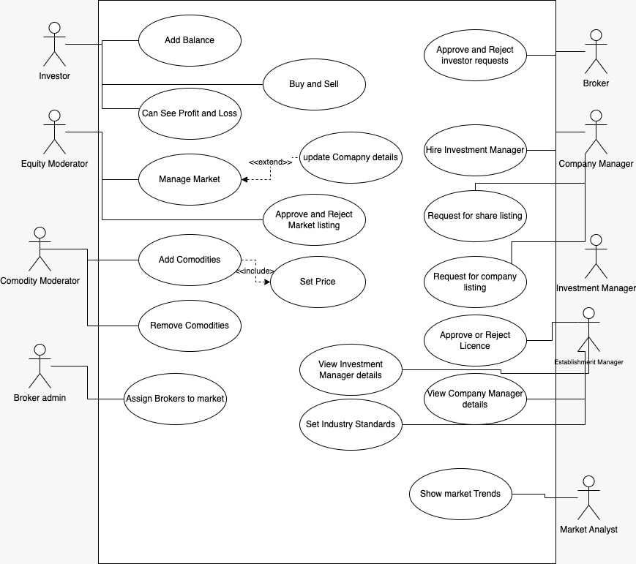
Use Case Diagram

Slide 8
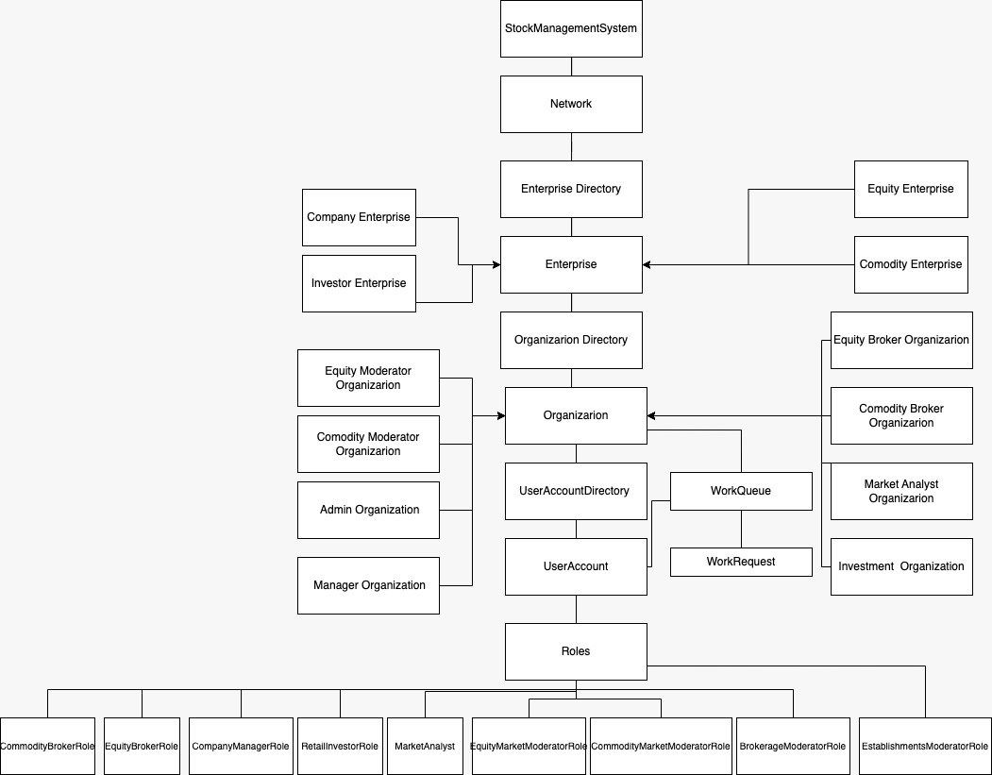
Sequence Diagram

Slide 9
Roles
Retail Investor: View and sell equities/commodities, add balance to their account.
Equity Broker/ Commodity Broker: They approve or reject the request of buying or selling of equity/commodity.
Analyst: Views market trends in graphs.
Broker admin: Can assign a broker to the market.
Commodity market Moderator: Can add new commodities, modify rate of commodity.
Company Manager: Add new stocks of company.
Establishment manager: Approve or reject the licence of the company, can see all the investment managers.
Investment manager: Can buy his own company stocks which can be approved or declined by respective equity broker.

Slide 10

OUTPUT SCREENS

Slide 11
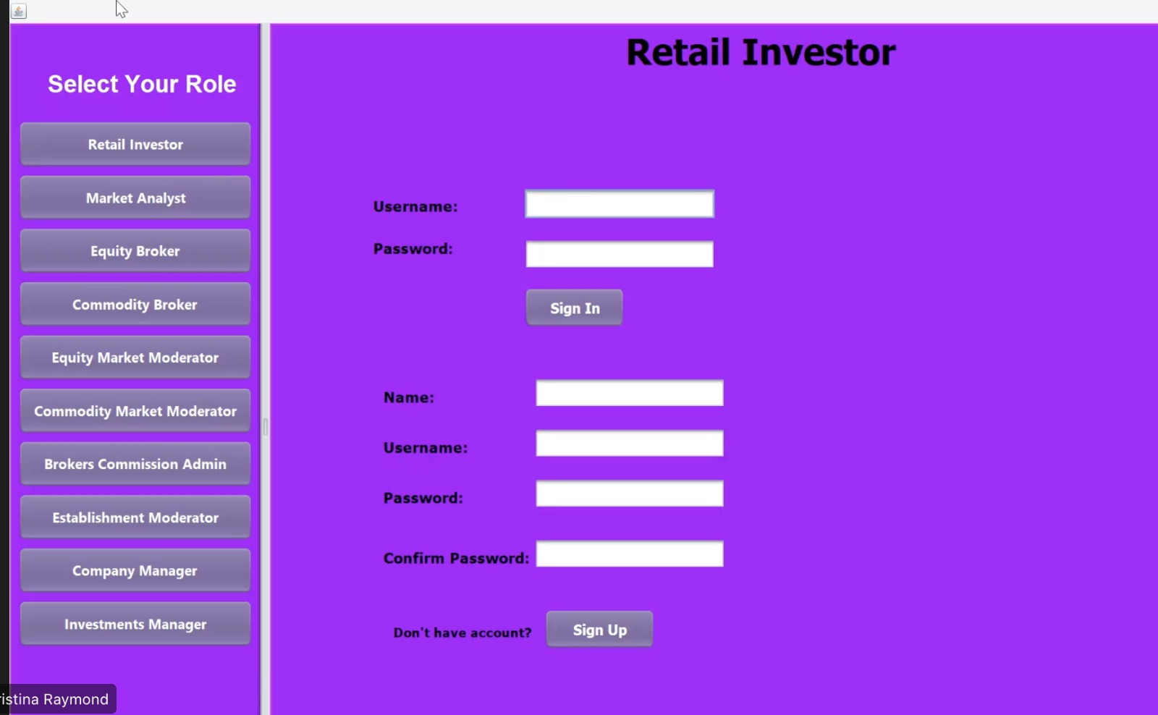
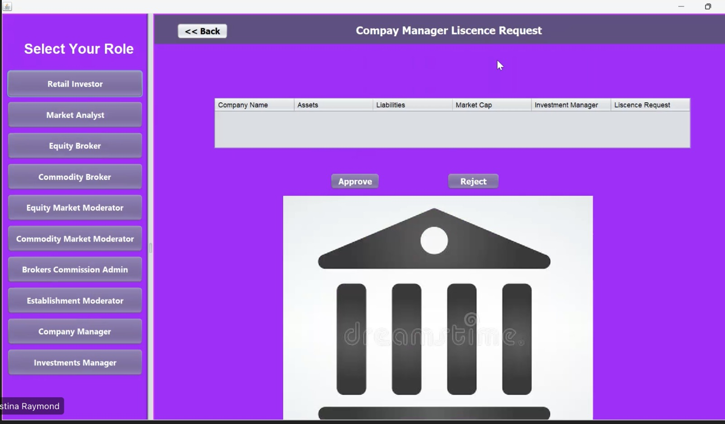

Slide 12
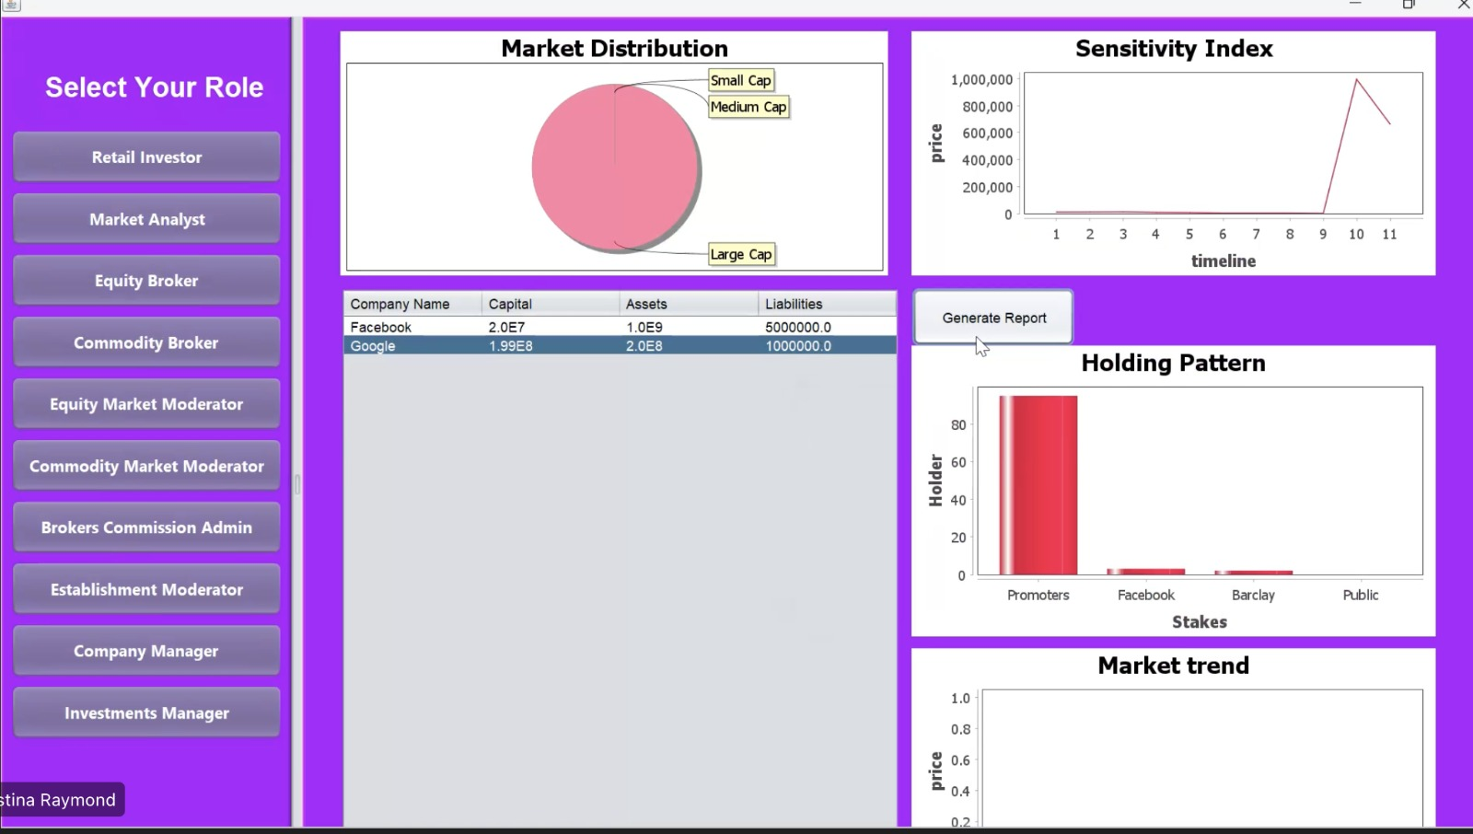
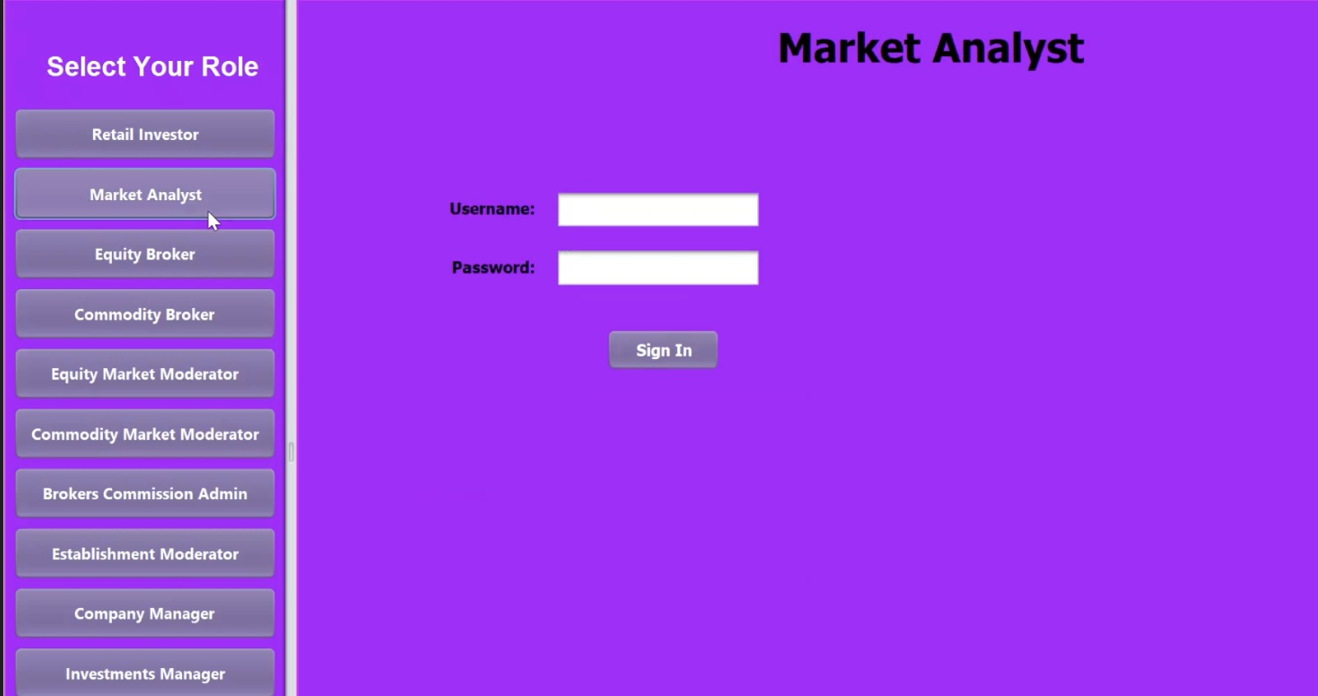

Slide 13
THANK YOU

